Slide 1
Lesson 5.2
Backend Programming

Slide 2
Learning Outcomes
Create local APIs
Run web server and consume local APIs
Apply request using all the different API methods from postman and/or browser
Debug and fix run time server-side or client-side errors

Slide 3
Task Manager App
Demo 1

Slide 4
Task Manager Application
Today we are going to create a full-stack web application that it used for managing tasks.
A task consists of the following data points:
ID: this is a unique identifier for each task (e.g. 1001).
Title: this is the title of the task (e.g. “Grocery shopping”).
Description: this is a longer description of what needs to be done (e.g. “Today I need to go shopping for…”)
The unique ID will be created using the current UNIX timestamp.
Epoch Converter - Unix Timestamp Converter
let timestamp = Date.now();

Slide 5
Task Manager Application
The task manager app should satisfy the four basic CRUD operations:
Create new tasks
Read
all tasks
an individual task
Update existing tasks
Delete existing tasks

Slide 6
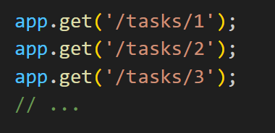
Dynamic Routes
Problem: since our app will contain many tasks, if we want to update an existing one, how do we create a route to find that specific one? We don’t want to make a route for every task:
Solution: we can create dynamic routes in Express by using route parameters.
Route parameters are named URL segments that are used to capture the values specified at their position in the URL.
The captured values are populated in the req.params object, with the name of the route parameter specified in the path as their respective keys.

Slide 7
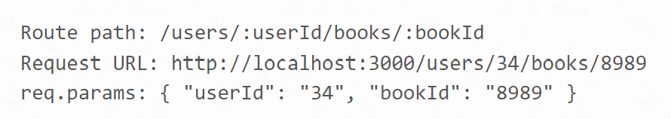
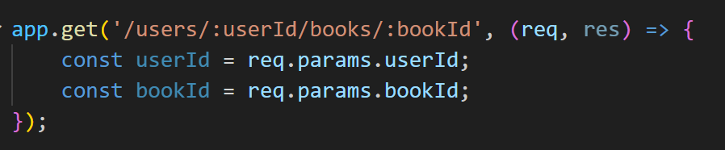
Dynamic Routes
In a web address, route parameters are like special slots that grab important values for the server. We mark these slots with a colon (:) and give them a variable name in the route.
To define routes with route parameters, simply specify the route parameters in the path of the route.

Slide 8
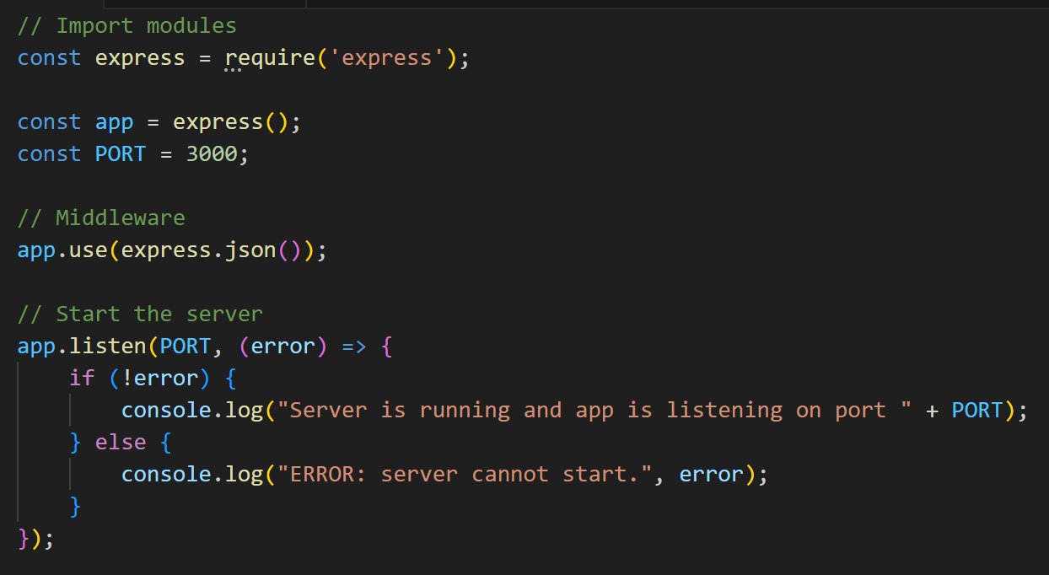
Application Setup
Setup a normal Node.js application:
Create a project directory.
Create an app.js file.
Run npm init to create the package.json file.
Run npm install express --save to install the express module.
Run npm install nodemon --save to install the nodemon module.
Create the start script in package.json: "start": "nodemon app.js",
Insert into app.js the normal code to create an express application.
Run npm start to start your application.

Slide 9
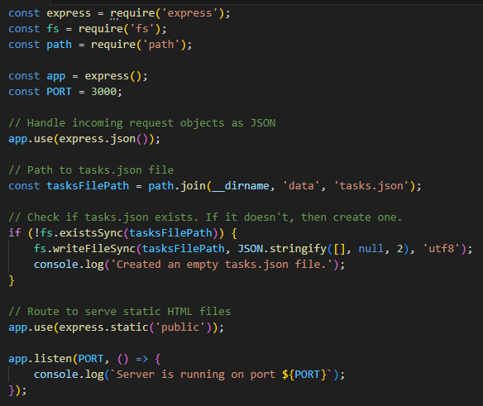
Directory Setup
Update our application to have a front-end and data storage.
Create a “public” folder and insert all the front-end files (CSS, HTML, JavaScript).
Update app.js to serve static files from that folder.
Create a “data” folder that will hold the JSON file(s) that store the app’s data. For us, this will be tasks.json.
Add the file system and path modules to app.js to access and manipulate data files.
Update app.js to include code that will check if the tasks.json file exists. If it doesn’t, then create it.

Slide 10
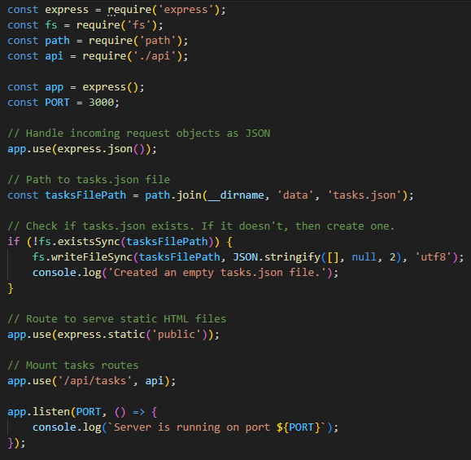
API Setup
Update our application to have an API with specific CRUD routes.
Create an api.js file that will define the routes to access and update the JSON file.
Update app.js to import the api.js file and then mount the routes at the URL “/api/tasks”.

Slide 11
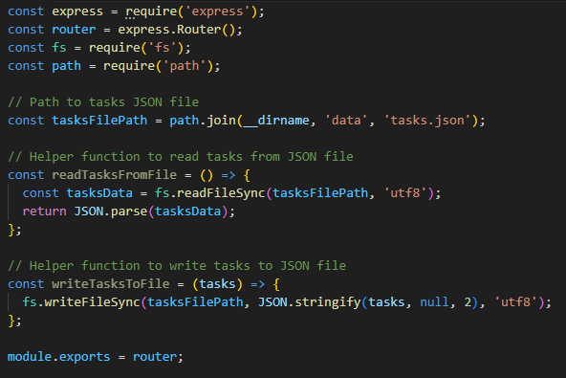
API Setup
Now its time to start building our API router in api.js.
Import express and create a router.
Export that router as a module.
We will be accessing and modifying the tasks.json file from here, so import the file system and path modules.
To assist us with reading from and writing to tasks.json, create a couple of helper functions to do that.
Next, let’s add our CRUD routes one-by-one…

Slide 12
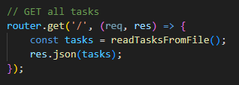
CRUD Routes
READ all tasks
The tasks.html file in the front-end has the job of displaying ALL tasks.
Its accompanying tasks.js script file makes a GET request to the endpoint “/api/tasks”.
This means that we need a GET route at “/” (since all the routes are mounted at “/api/tasks”).
This GET route should read all the tasks from data and send them in JSON format.
Add this route to api.js.

Slide 13
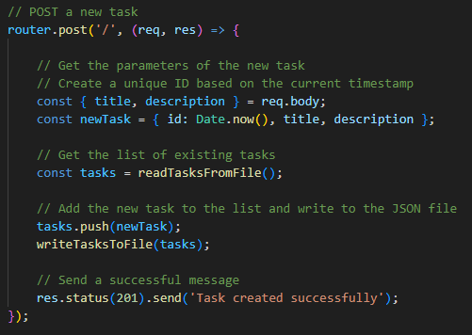
CRUD Routes
CREATE a task
The create-task.html file in the front-end has the job of creating a new task.
Its accompanying create-task.js script file makes a POST request to the endpoint “/api/tasks”.
This means that we need a POST route at “/” (since all the routes are mounted at “/api/tasks”).
This POST route should create a new task using the parameters from the request’s body and an ID from a date timestamp.
It should then add the new task to the data storage.
Add this route to api.js.

Slide 14
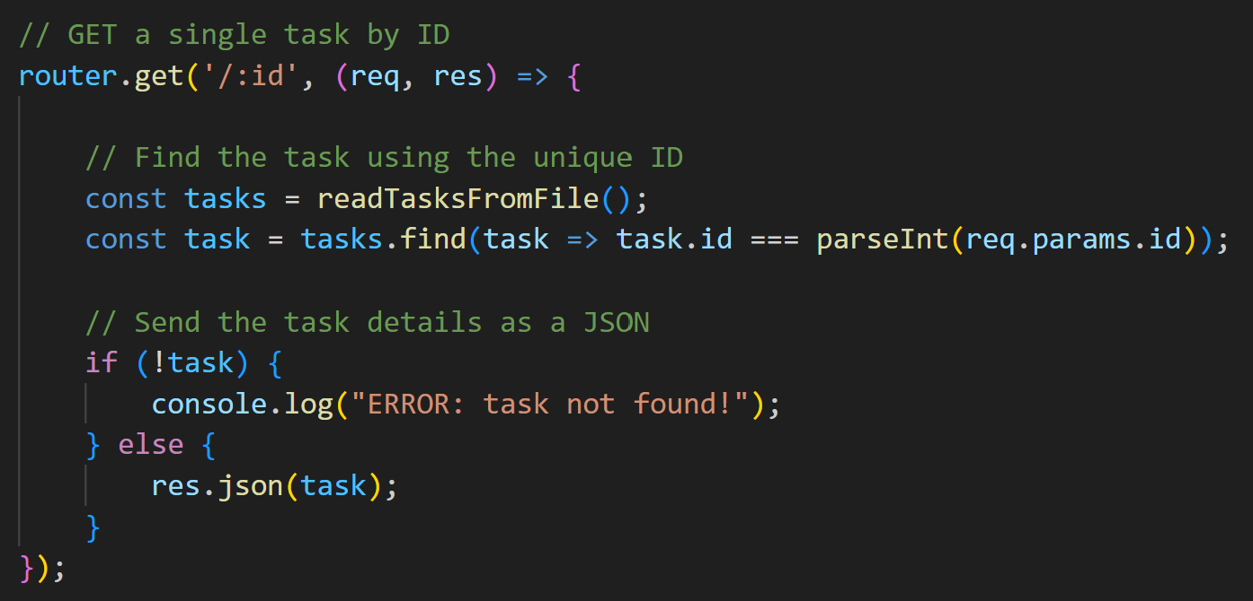
CRUD Routes
READ a single task
The task.html file in the front-end has the job of displaying a single task. On this page the user can choose to update or delete that task.
Its accompanying task.js script file makes a GET request to the endpoint “/api/tasks/:id”, where :id is the task’s ID.
This means that we need a GET route at “/:id”.
This GET route should search through the data to find the matching task based on the :id parameter. It should send that task in JSON format.
Add this route to api.js.

Slide 15
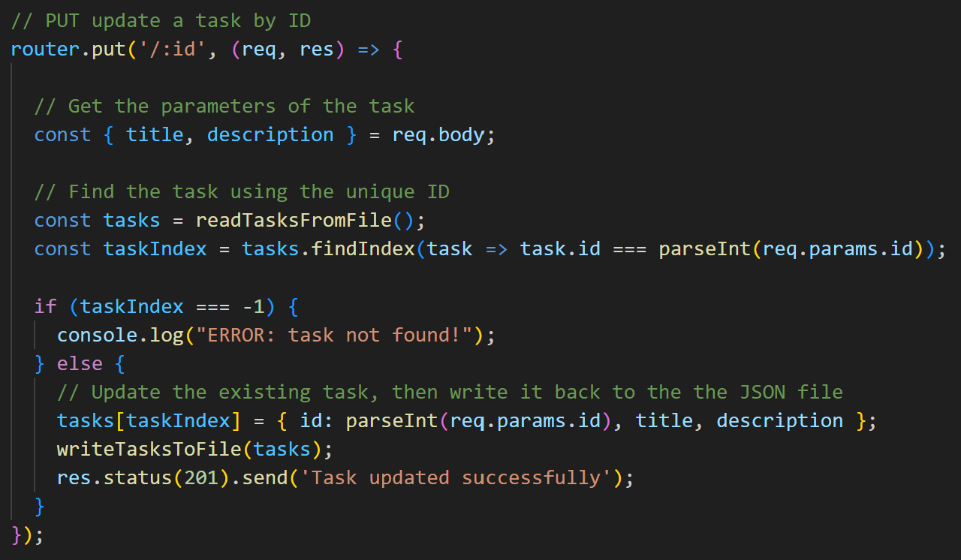
CRUD Routes
UPDATE an existing task
The update-task.html file in the front-end has the job of letting users update an existing task.
Its accompanying update-task.js script file makes a GET request to the endpoint “/api/tasks/:id”, where :id is the task’s ID. We already created this.
It also makes a PUT request to the endpoint “/api/tasks/:id”, where :id is the task’s ID.
This means that we need a PUT route at “/:id”. This route should update the existing task using the parameters from the request’s body. The ID remains the same.
It should then save the updated task to the data storage.
Add this route to api.js.

Slide 16
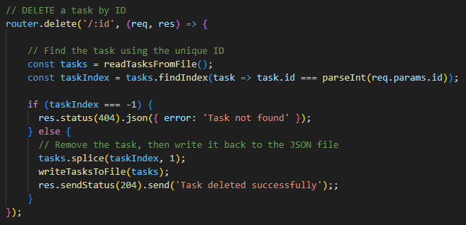
CRUD Routes
DELETE an existing task
The task.html file in the front-end has the job of letting users delete an existing task.
Its accompanying task.js script file makes a DELETE request to the endpoint “/api/tasks/:id”, where :id is the task’s ID.
This means that we need a DELETE route at “/:id”. This route should delete the existing task using the ID from the parameter and save the result in data storage.
Add this route to api.js.

Slide 17
Finished!
All my CRUD routes are now in place.
Users can browse my front-end files freely as they are all in the “public” folder, which my back-end has made publicly available as static files. No routes are needed to access them.
My front-end files can make API requests to the back-end to Create tasks, Read tasks, Update tasks, and Delete tasks.
All my data is stored in JSON files in the “data” folder, and my API is responsible for accessing and updating it.
I have a full-stack web application!

Slide 18
Library Management App
Demo 2

Slide 19
Library Management Application
I am going to demonstrate a full-stack web application that it used for finding authors and books in a pre-existing data set:
Authors
ID
Name
Birth year
Books
ID
Title
Publication year
An author can have many books.

Slide 20
Library Management Application
The app can search for authors or books in the data set, and then display the results on the screen.
App can only READ results. No creating, updating or deleting.
Two ways to enable search capability:
Send search parameters from the front-end to the back-end, let the back-end do the searching, then send the results to the front-end.
Have the back-end send all the resources to the front-end, then the front-end does the searching and displays only the results.

Slide 21
Teacher Evaluations
Teacher and course evaluations are now open.
Please send me constructive feedback.
Closes August 23.

Slide 22
For next class
Read Lesson 5.3 and do Learning Activity 5.3.1.
Assessments Reminder:
Quiz 2 due August 15, 8:00am.
Assignment 2 due August 20, 8:00am.
Group Project due August 22, 11:59pm.
All assessment dates have been posted in D2L.
See the “Assignments Policy” for late submission procedures.

Slide 23
References
https://expressjs.com/en/guide/routing.html
https://www.geeksforgeeks.org/how-to-handle-route-parameters-in-express/

